Slide 1
Sign Language MNIST
Kaggle link : https://www.kaggle.com/datasets/datamunge/sign-language-mnist

Slide 2
Problem statement :
Build a system that can correctly identify American Sign Language signs that corresponds to the hand gestures.

Slide 3
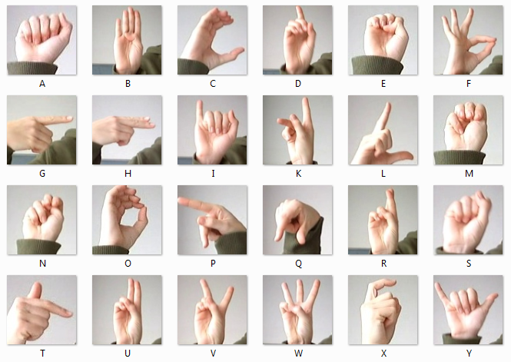

Slide 4
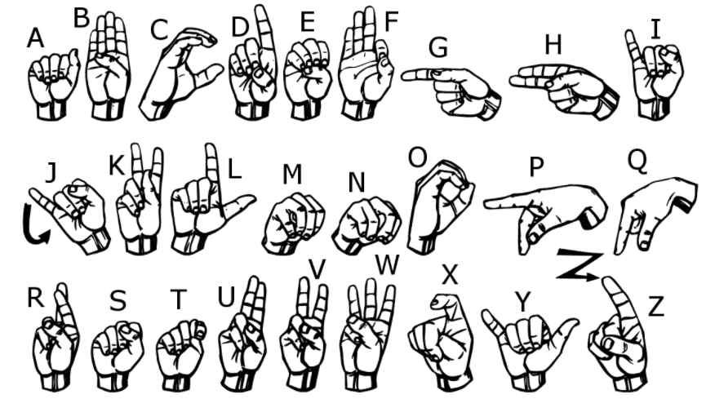

Slide 5
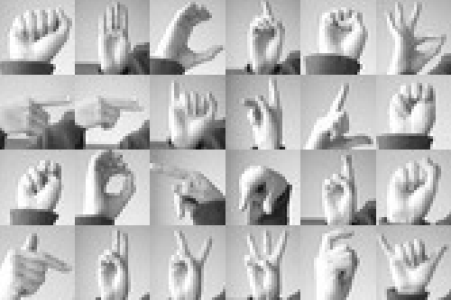

Slide 6
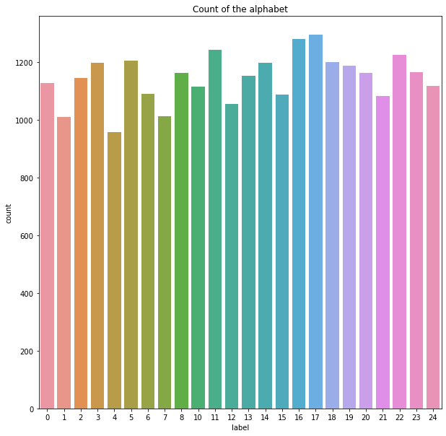
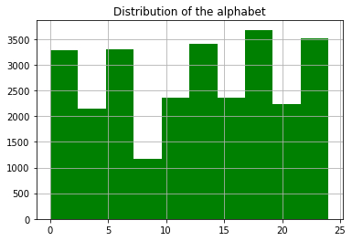
Count of alphabet :

Slide 7
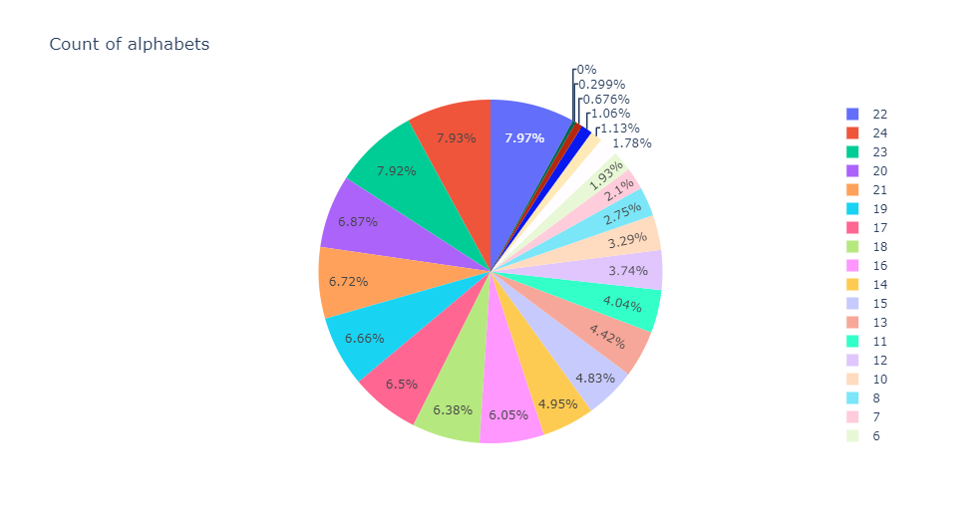
Pie chart :

Slide 8
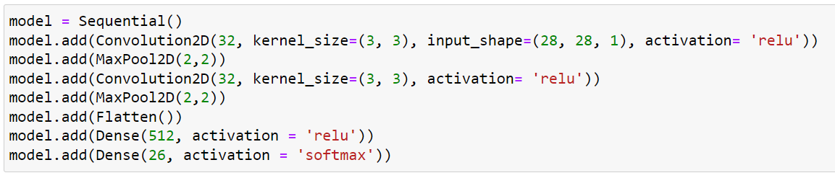
Model :

Slide 9
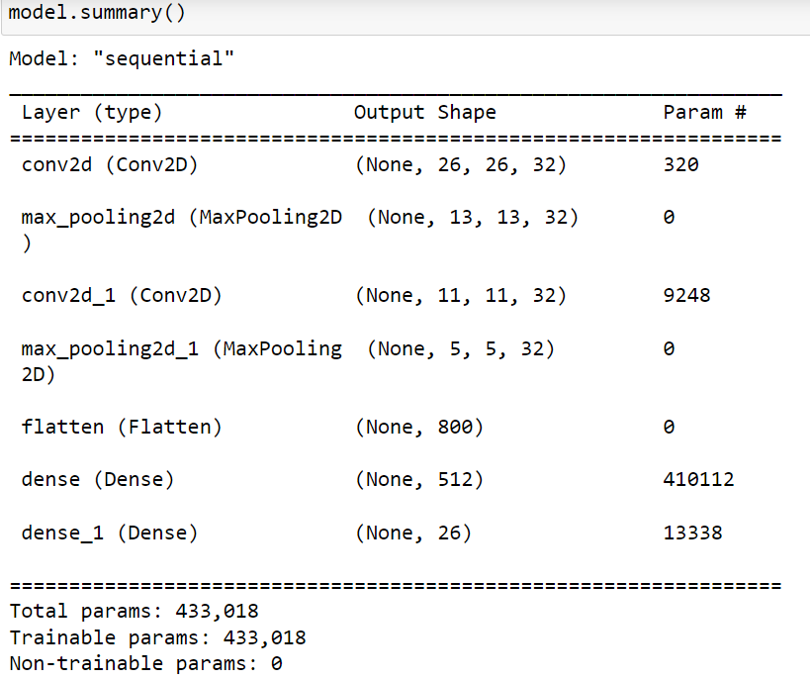

Slide 10
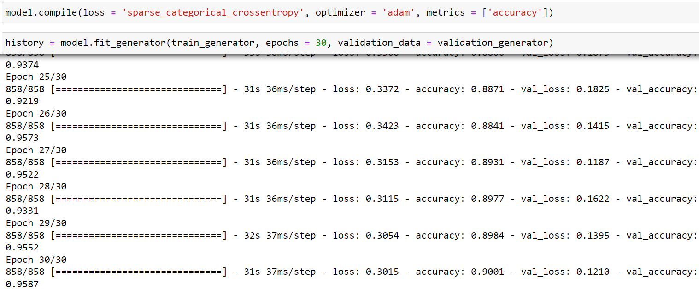

Slide 11
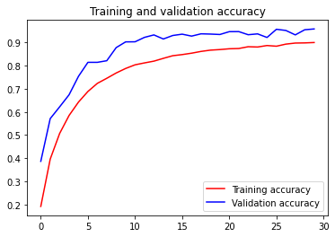
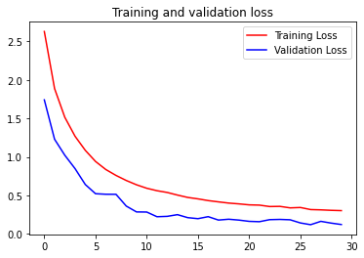

Accuracy :

Slide 12
Conclusion :
While this analysis sets a solid baseline for American Sign Language recognition, more work needs to be done to apply this concept in real-time. This would require further work with the Leap Motion API to enable real-time generation of data, feeding through the model, and identification of the word and/or numbers. This would also require the model to be able to handle more than the 60 class labels it currently deals with.
In conclusion, we see this application having real potential in improving the lives of the hearing-impaired and as such it would be a worthy goal to continue development.

Slide 13
Applications :
Our proposed system will help the deaf and hard-of-hearing communicate better with members of the community. For example, there have been incidents where those who are deaf have had trouble communicating with first responders when in need. Although responders may receive training on the basics of ASL, it is unrealistic to expect everyone to become fully fluent in sign language. Down the line, advancements like these in computer recognition could aid a first responder in understanding and helping those that are unable to communicate through speech.
Another application is to enable the deaf and hard-of-hearing equal access to video consultations, whether in a professional context or while trying to communicate with their healthcare providers via telehealth. Instead of using basic chat, these advancements would allow the hearing-impaired access to effective video communication.

Slide 14

Thank You So Much…..

